Slide 1
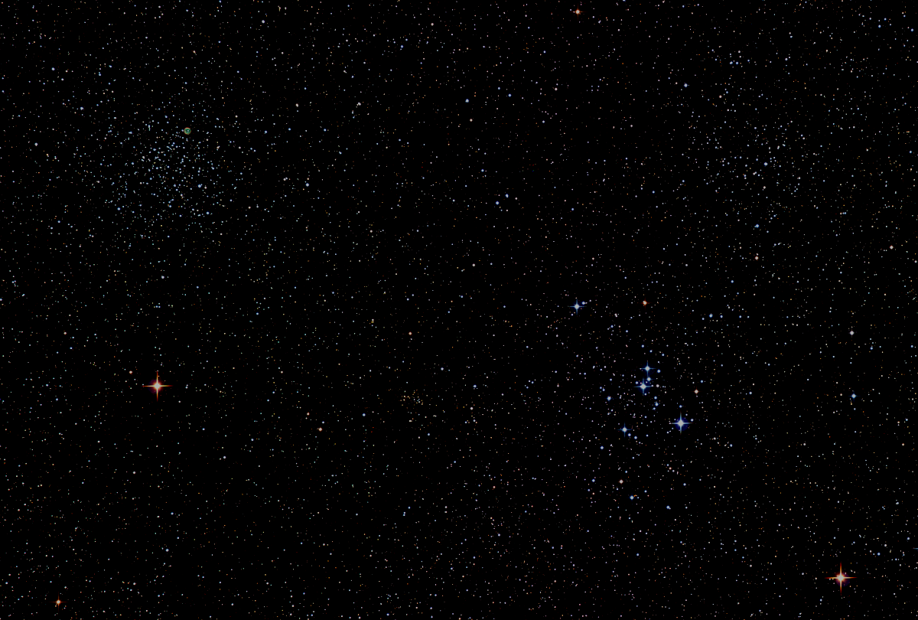

Howard
Astronomical
League
21
April 15, 2021
Notes:
Howard Astronomical League, February 20, 2020

Slide 2
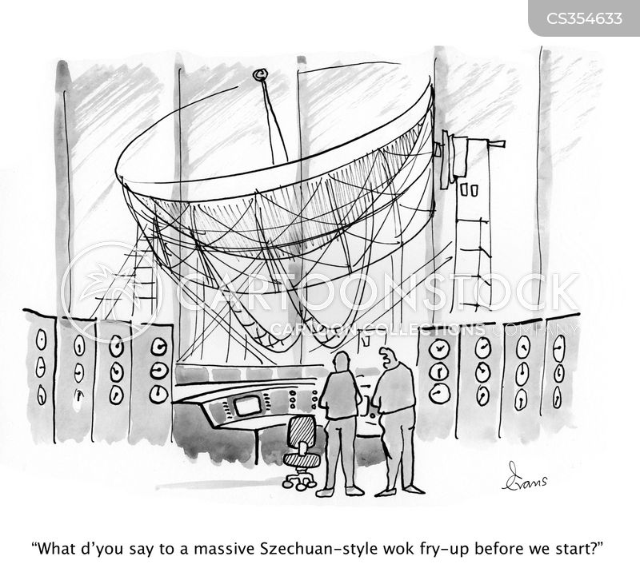
Astro Humor

Slide 3

Welcome New Members and Guests

Slide 4
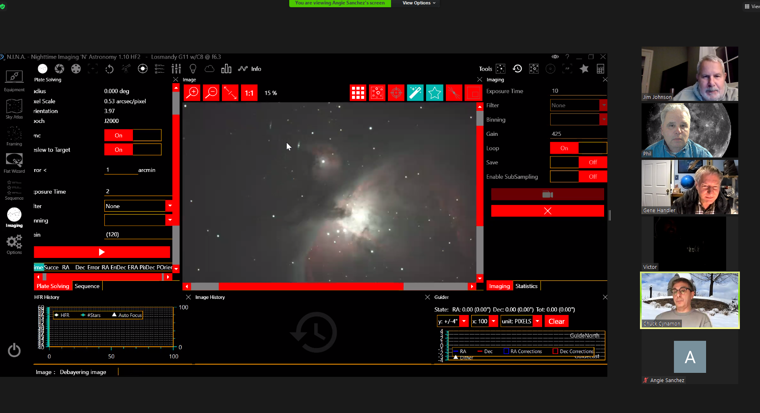
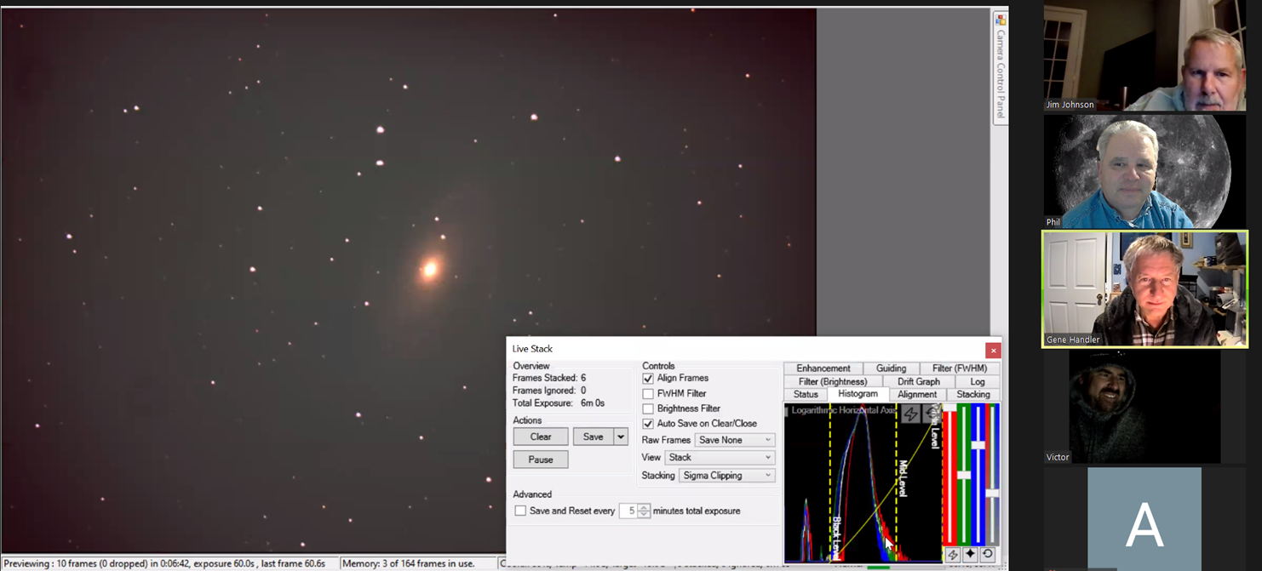
Public Star Party - Virtual
Starring
Gene Handler
Chuck Cynamon
Brad Martin
Jim Johnson
Corey Koval
This Saturday Night
8:00PM

Slide 5
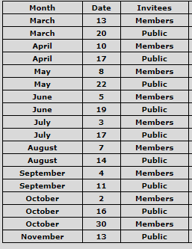
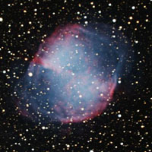
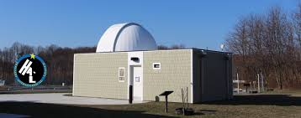
HAL Public Star Parties (Virtual and hopefully soon in-person)

Slide 6
Impromptu Star Parties
Alpha Ridge is open for a keyholder to call an Impromptu with the following provisions:
1) HALO will remain closed, except to the keyholder to turn off/on the parking lot and restroom lights and to turn on power to the exterior SE corner of HALO.
2) The restrooms are open.
3) The keyholder is responsible for closing the gate after entering and keeping lock separately until locking up at the end of the observing session.
4) Members will be informed that the gate is being left closed except for entry and exit. Members will be asked to open the gate inwards and close the gate behind them upon arrival and to repeat the routine upon departure.
5) Members will be reminded that all social distancing protocols currently called for in Howard County will be in effect.

Slide 7

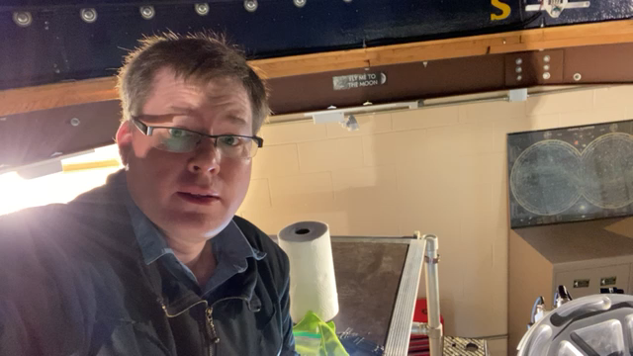
HALO
Maintenance

Slide 8
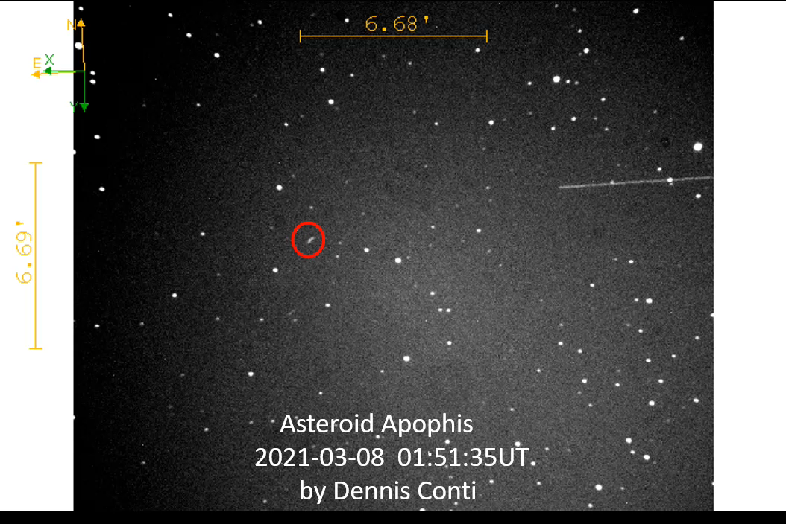

Slide 9
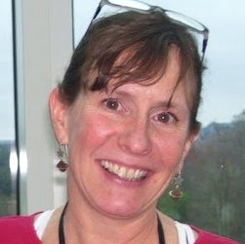
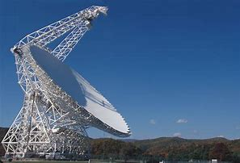
Tonight’s Guest Presenter
Sue Ann Heatherly
Senior Education Officer
Green Bank Observatory
Topic: Green Bank Telescope
and Radio Astronomy

Slide 10

May HAL Meeting May 20th

Slide 11
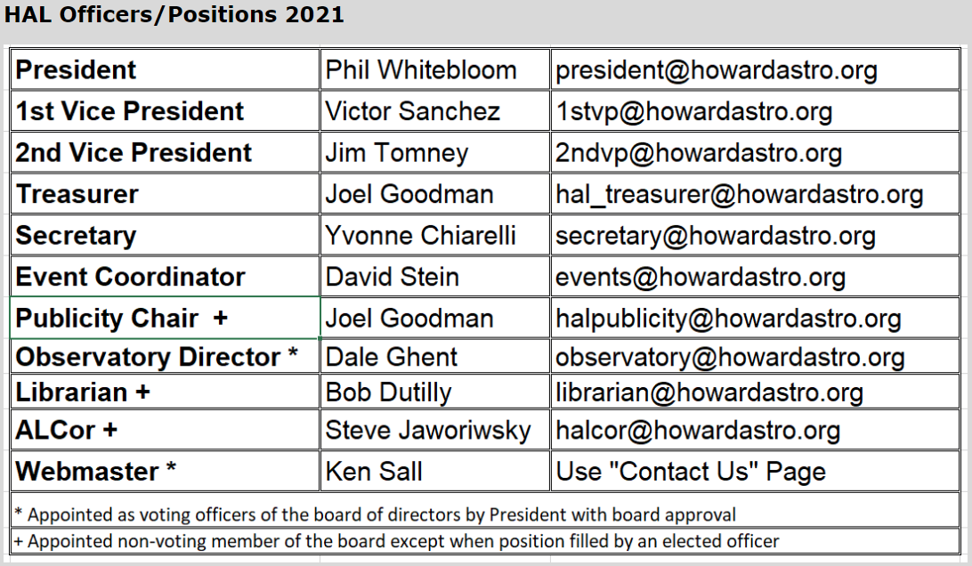
Officer Reports

Slide 12
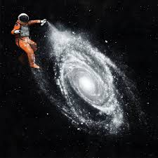
HAL Members Astro Art
And Projects

Slide 13
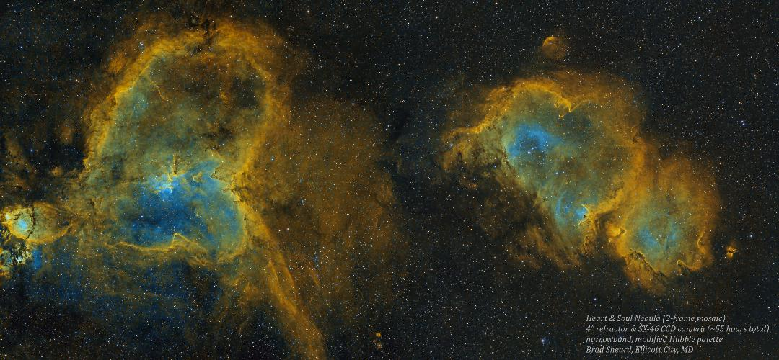

Slide 14
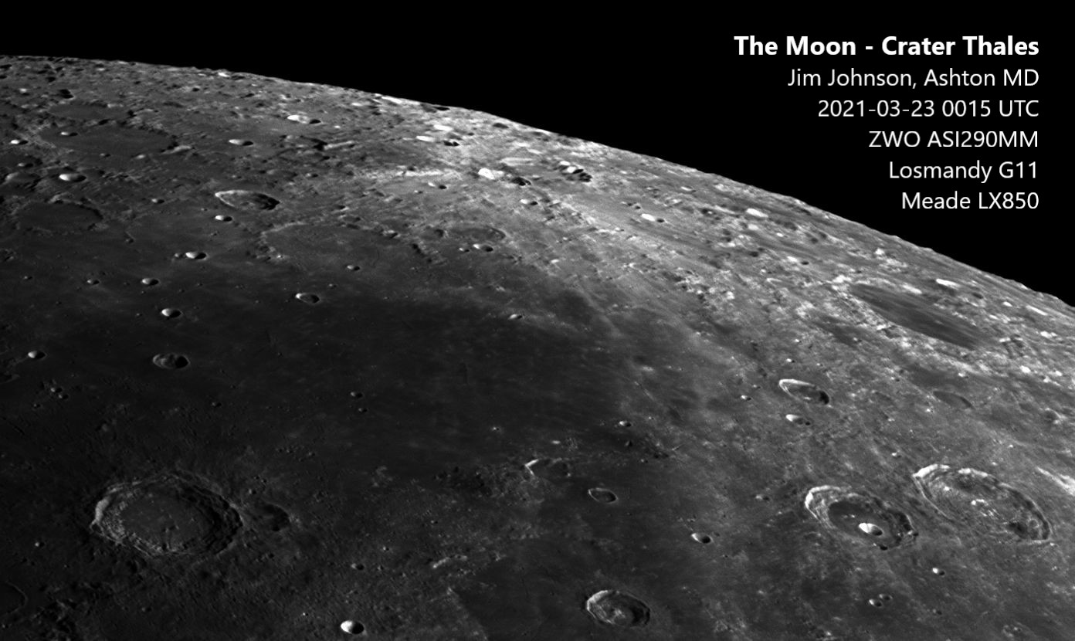

Slide 15
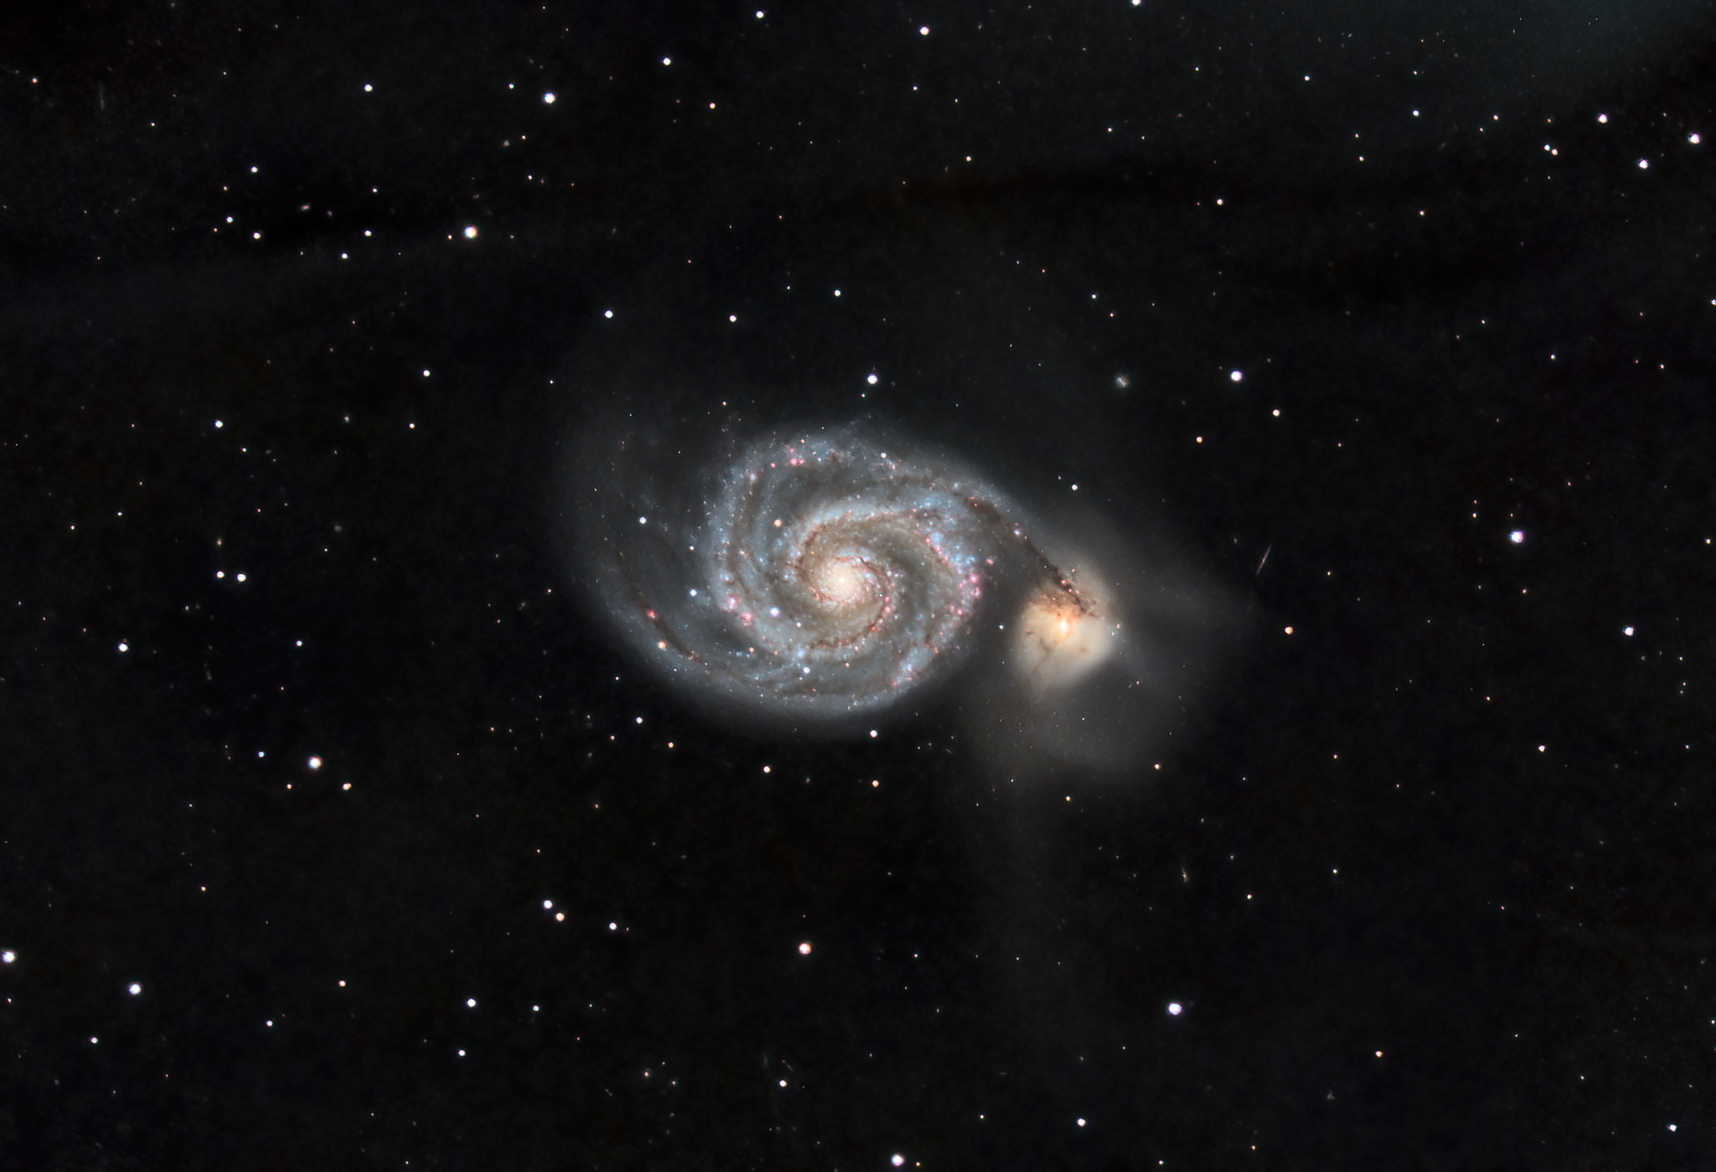
Victor Sanchez – M51

Slide 16
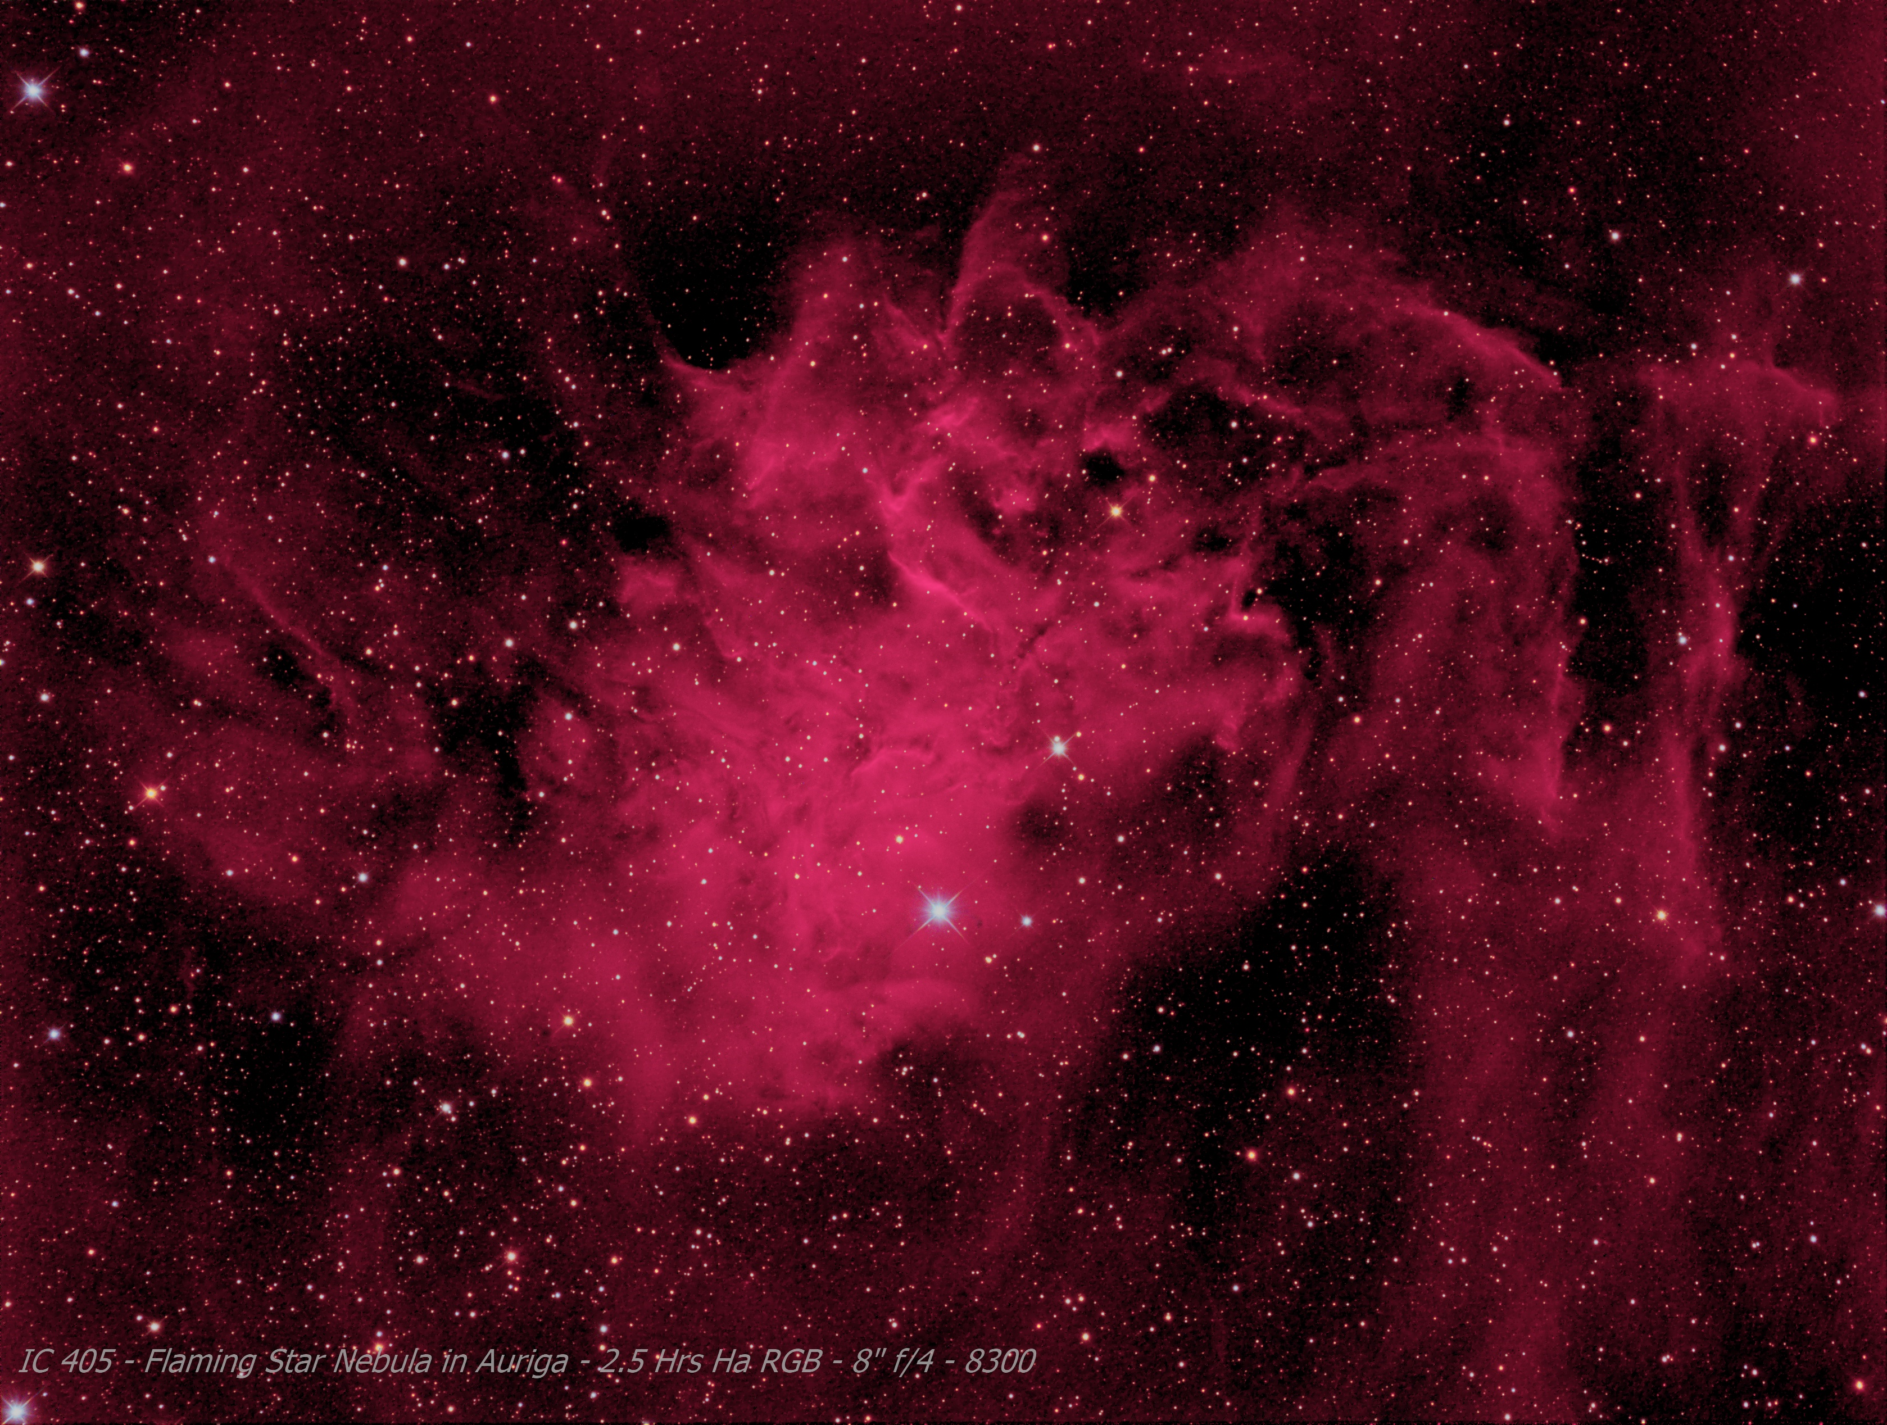

Slide 17
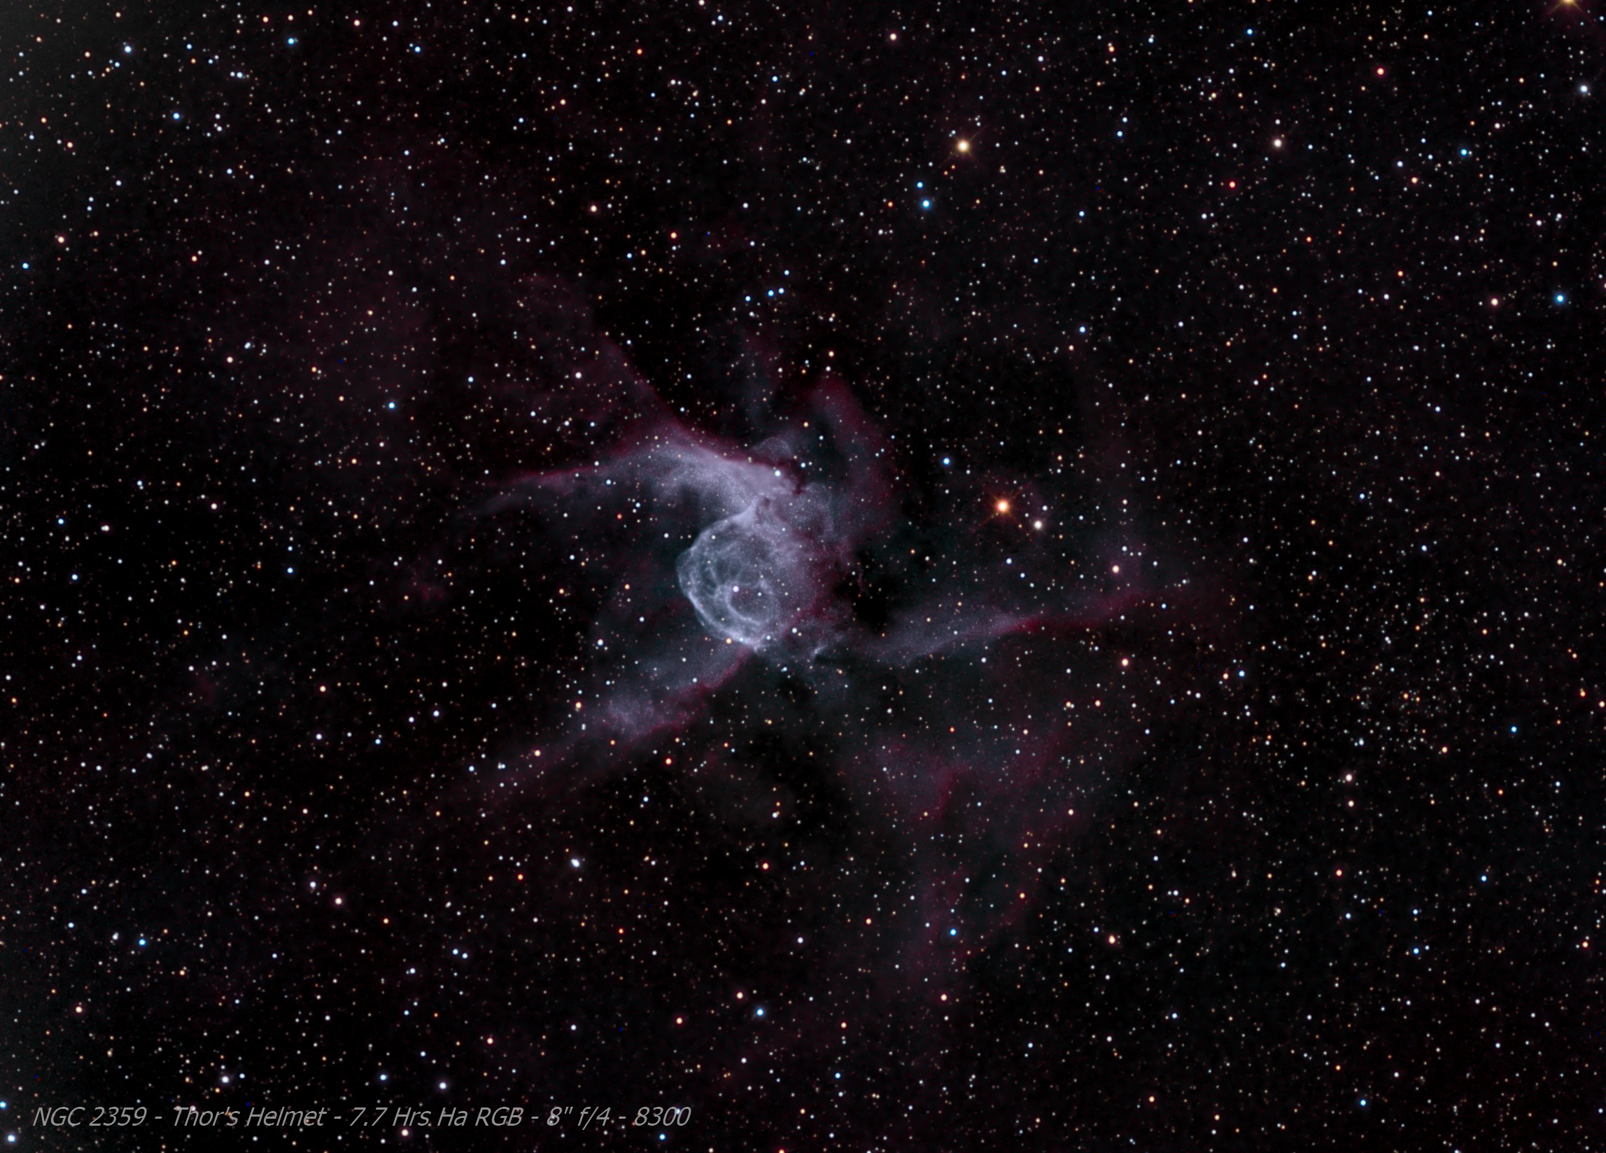

Slide 18
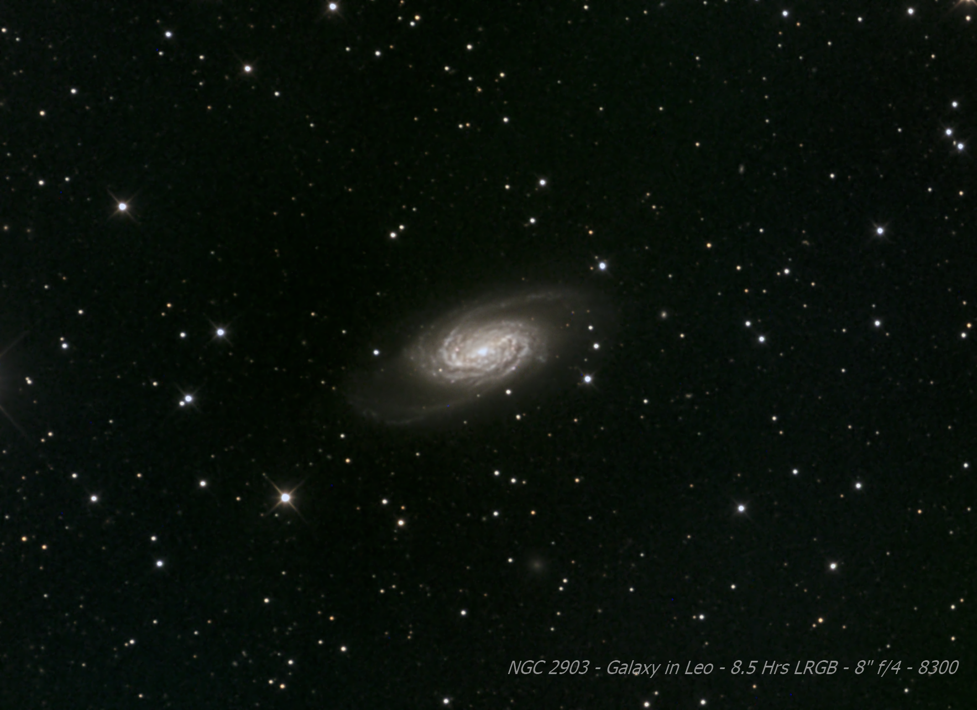

Slide 19
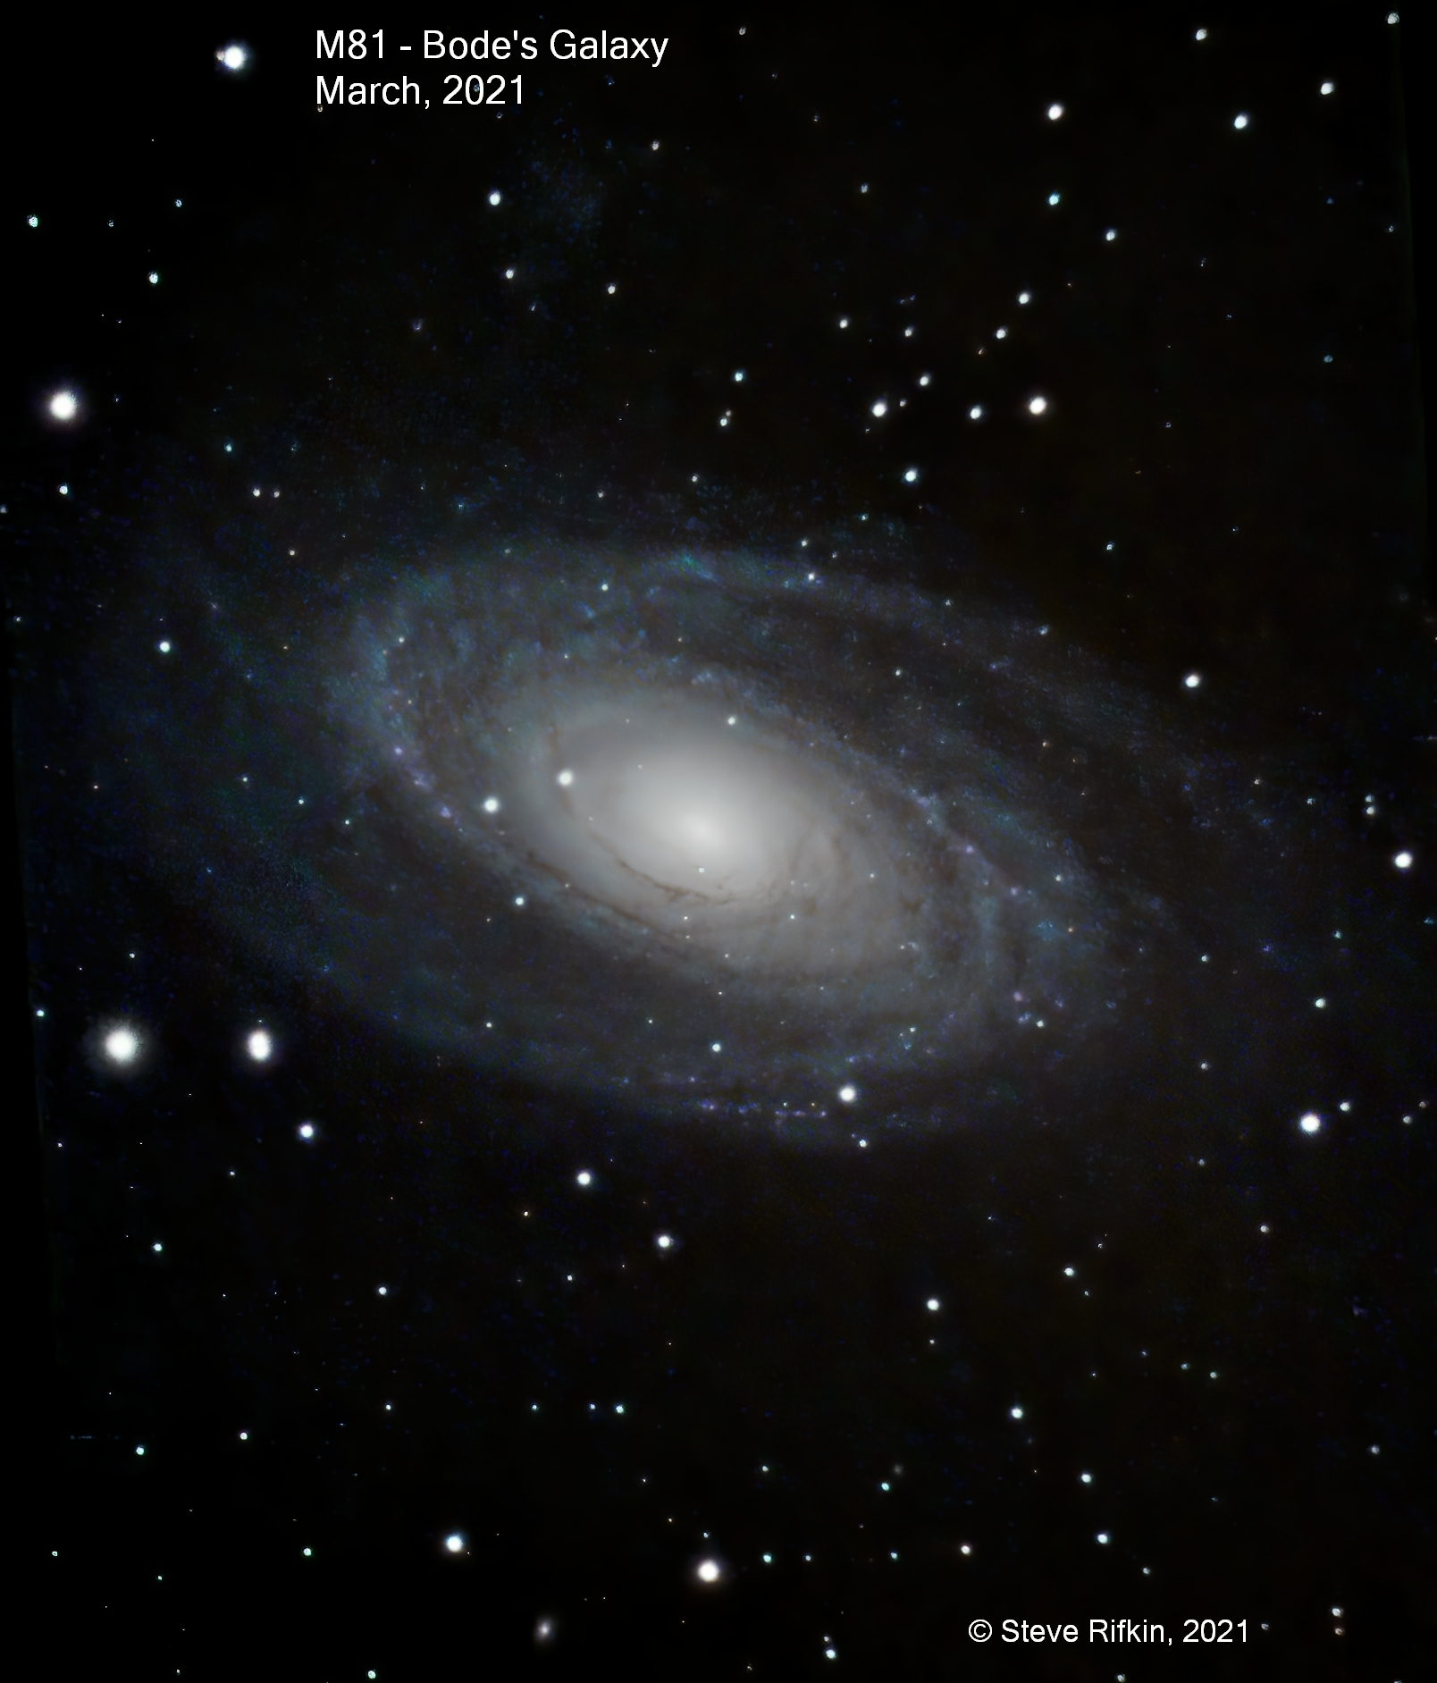

Slide 20
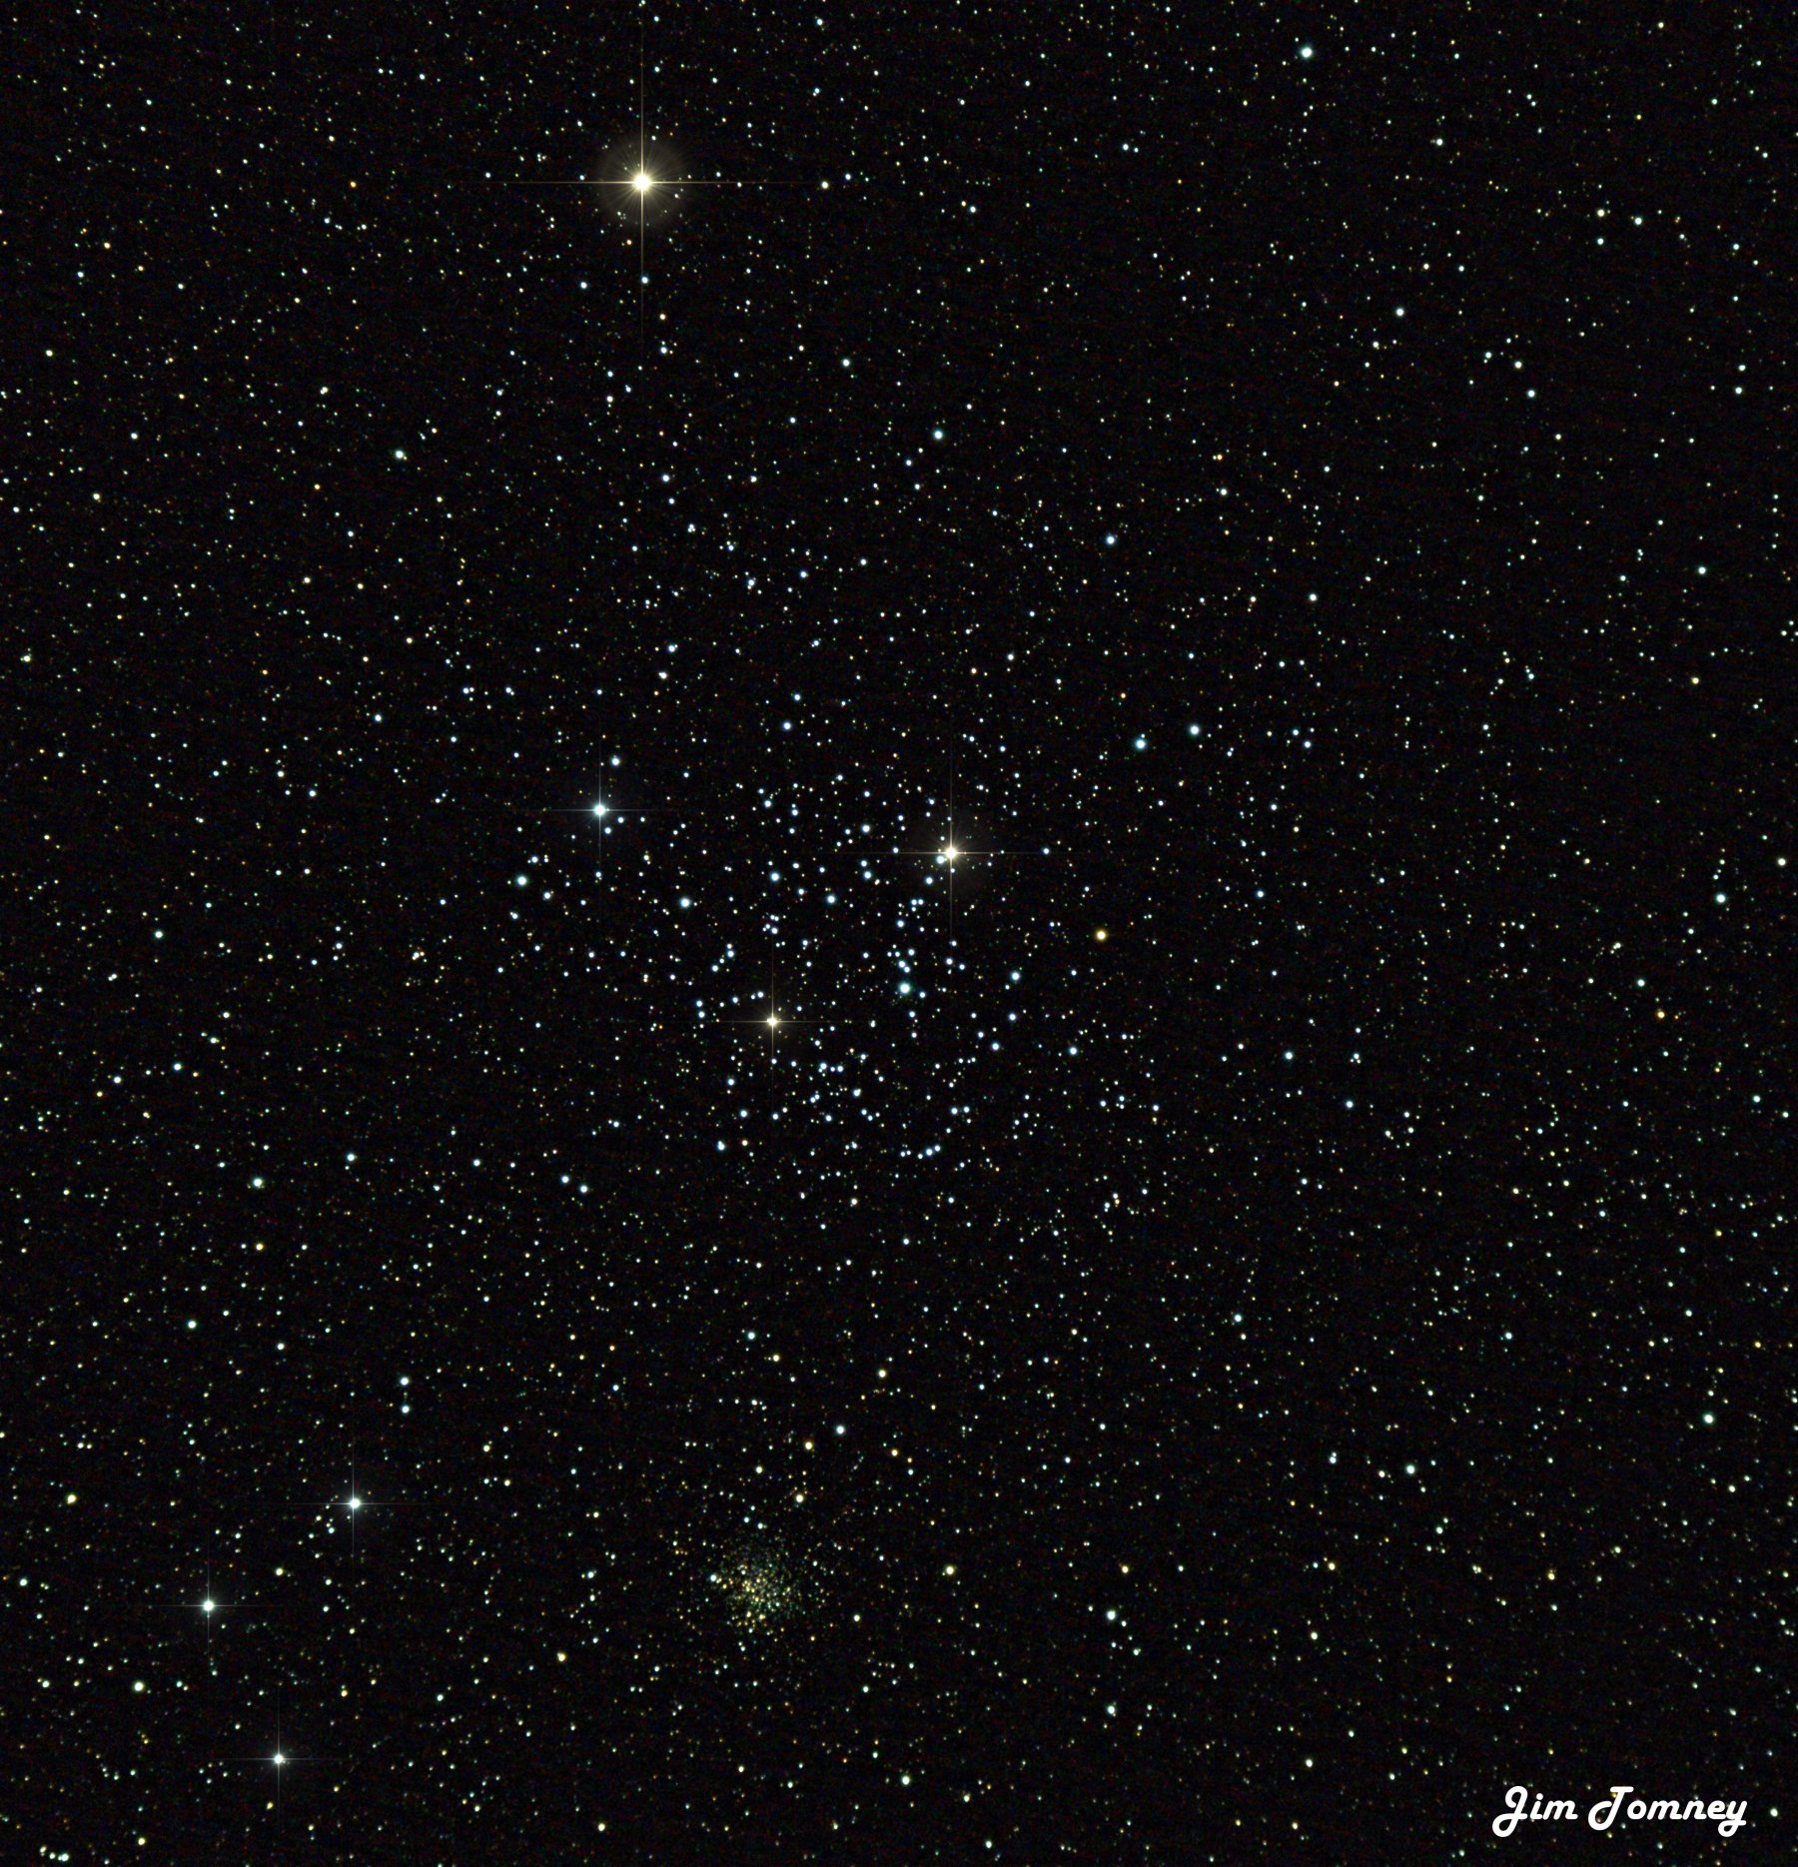
M35 and NGC 2158, Open Clusters in Gemini
M35 is a young cluster (100-200 million years old) that checks in at magnitude 5.3, spanning about size of full Moon and lying 3,870 ly out.
NGC 2158 is a smaller, older open cluster ~2 billion years old. It’s a background object lying about another 9K ly farther out. It’s easy to see why it was at first thought to be a globular cluster.
Just shy of 20 minutes worth of subs taken March 29, 2021 from Towson, MD (Bortle 8)
Vixen 80mm f7.5 refractor on CGX-L Mount
Canon Rebel t6s camera
Processing:
DeepSkyStacker
PixInsight
Topaz AI DeNoise
StarSpikes Pro

Slide 21
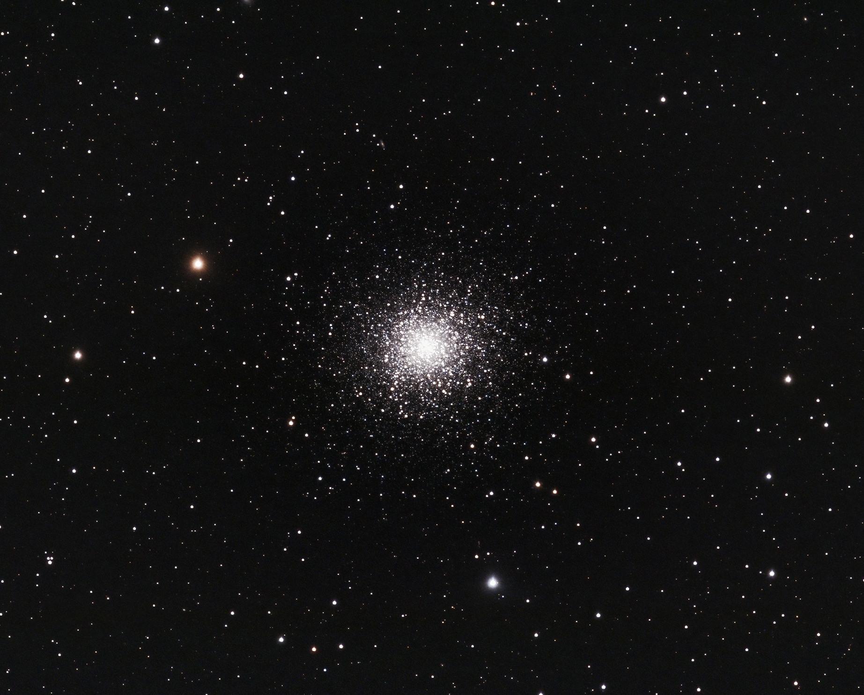
Brad Martin – M13

Slide 22
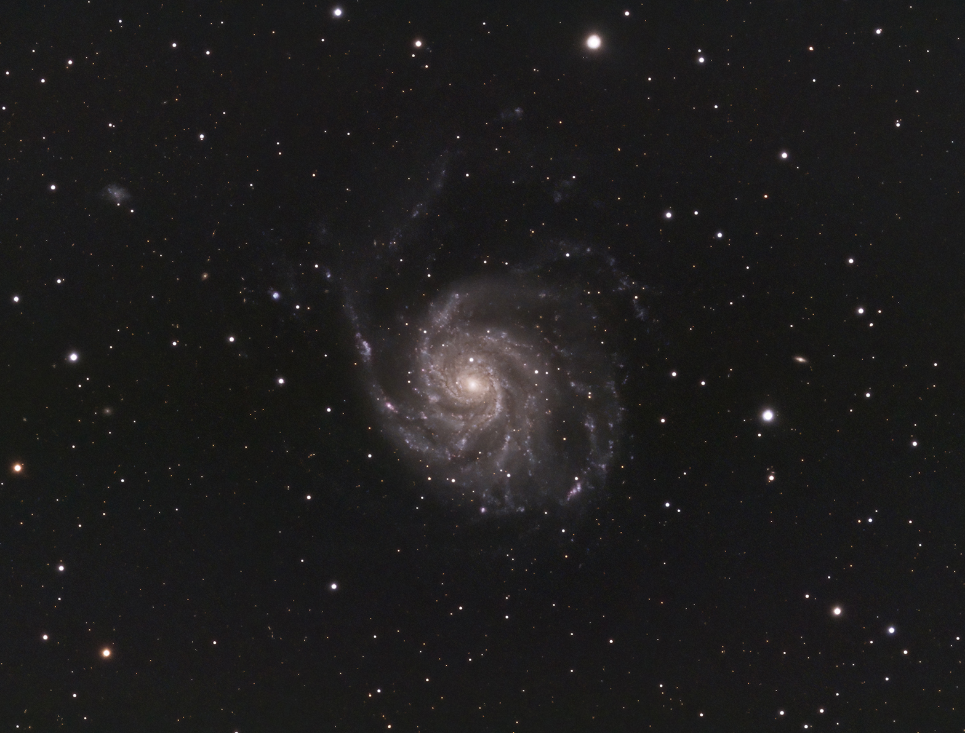
Brad Martin – M101

Slide 23
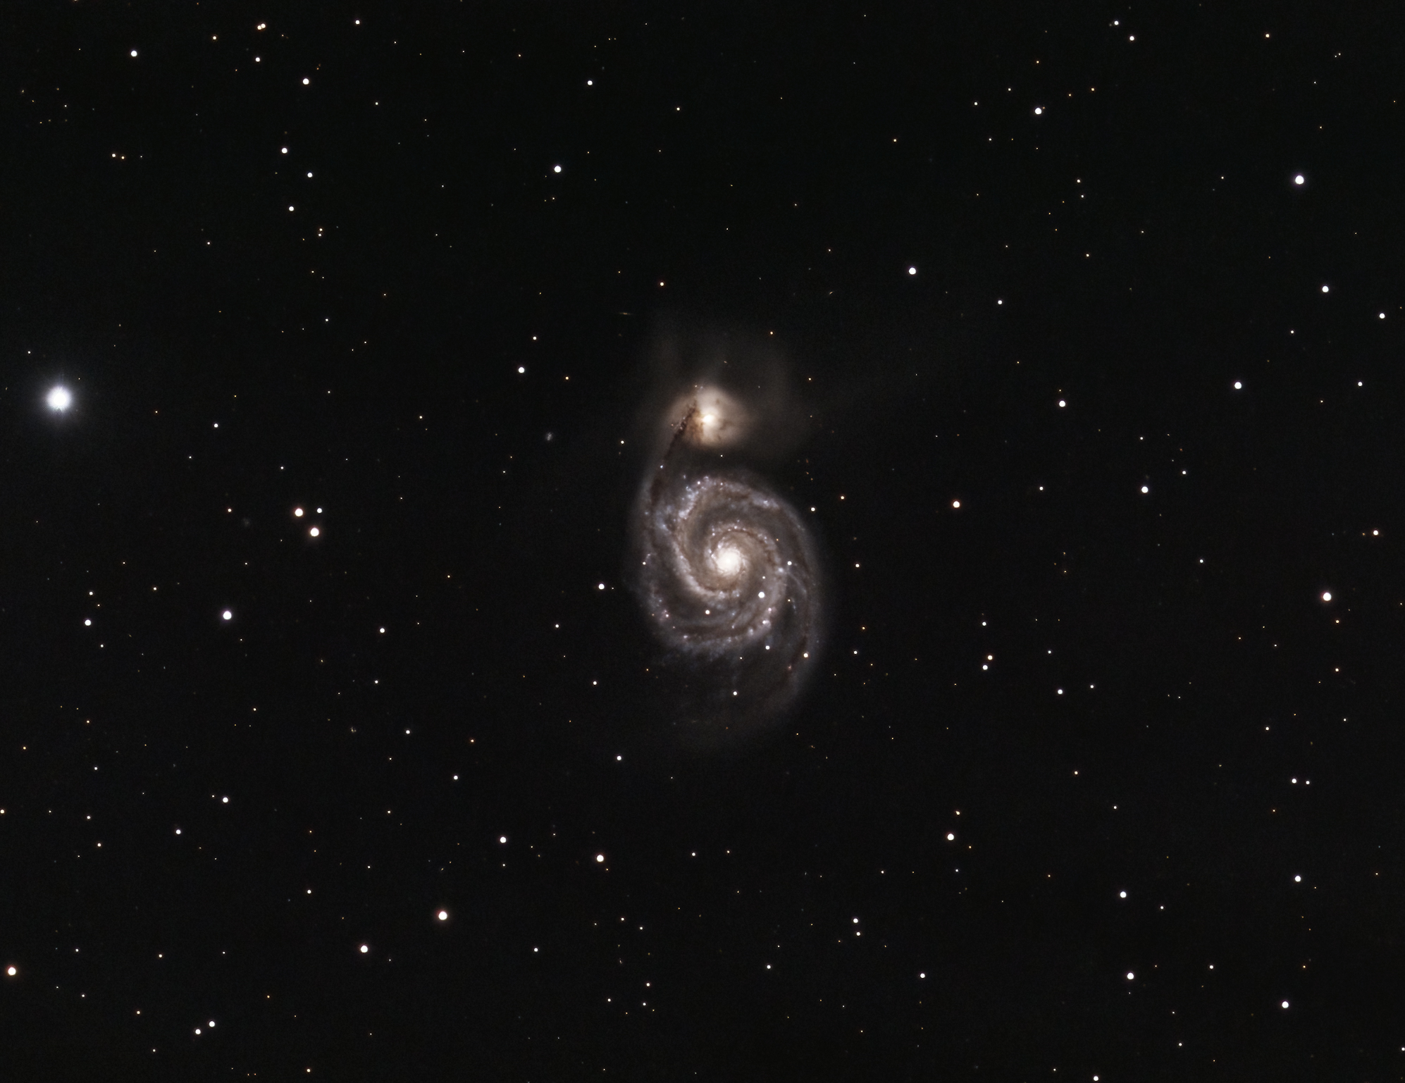
Brad Martin – M51

Slide 24
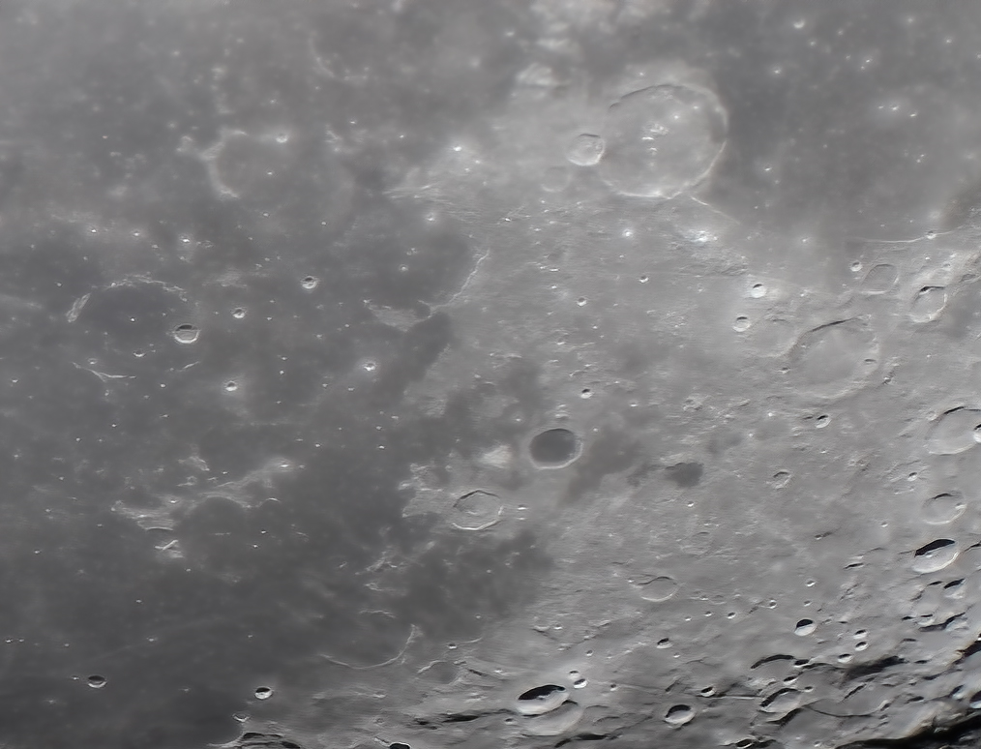
Brad Martin – Mons Hansteen

Slide 25
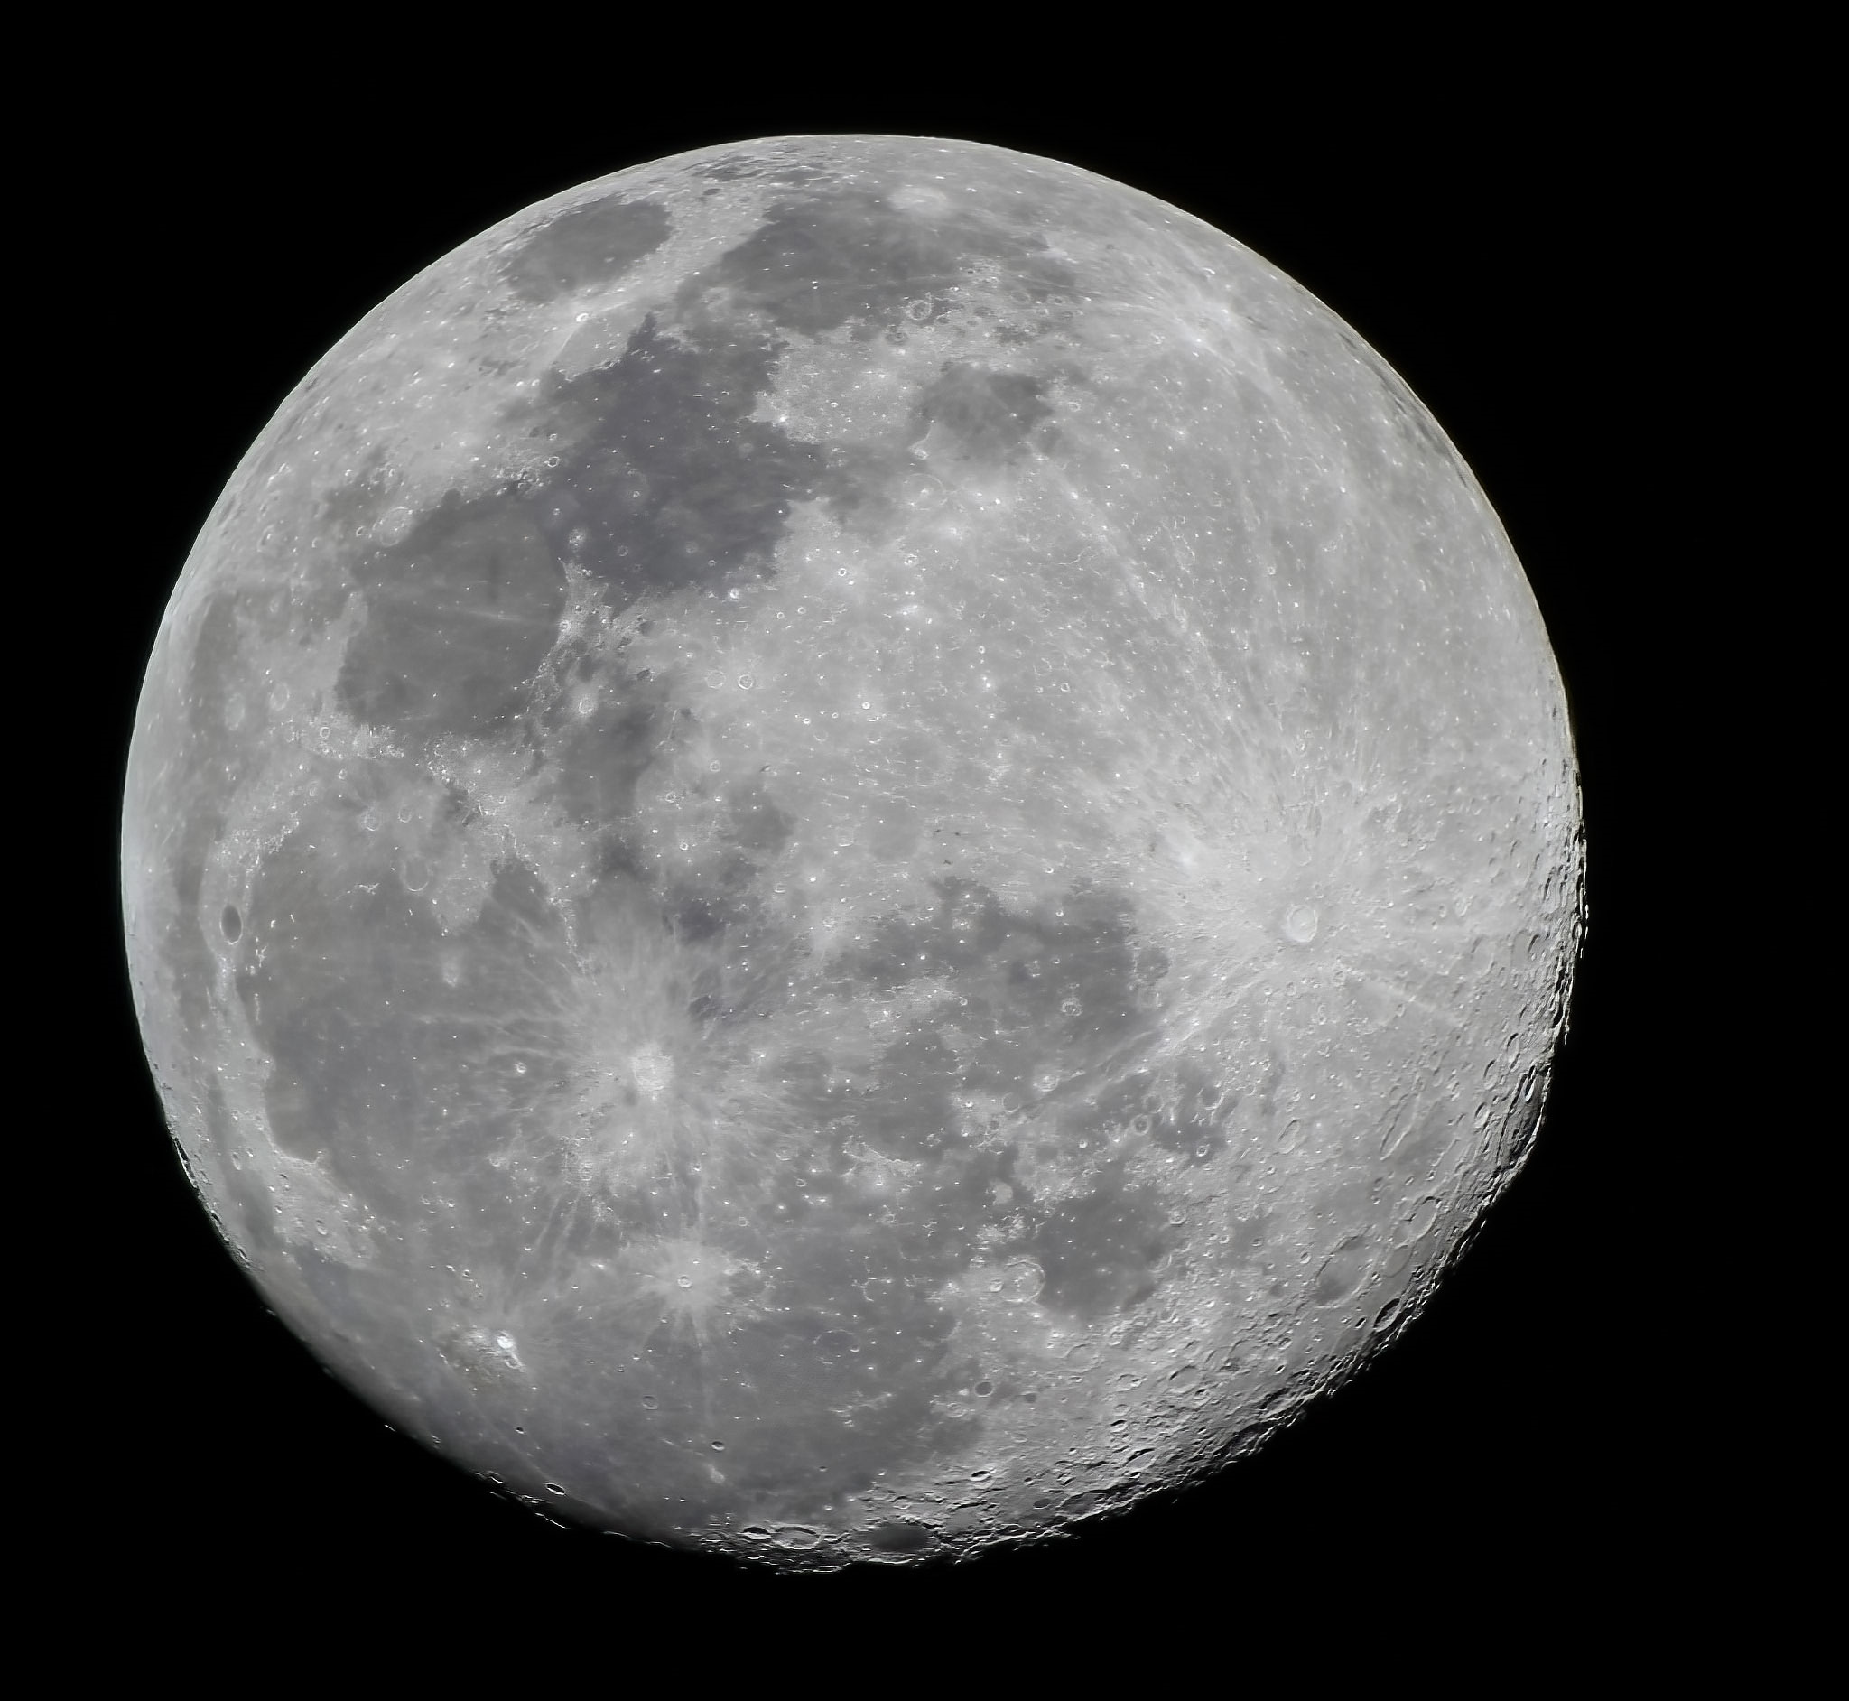
Brad Martin – Moon

Slide 26
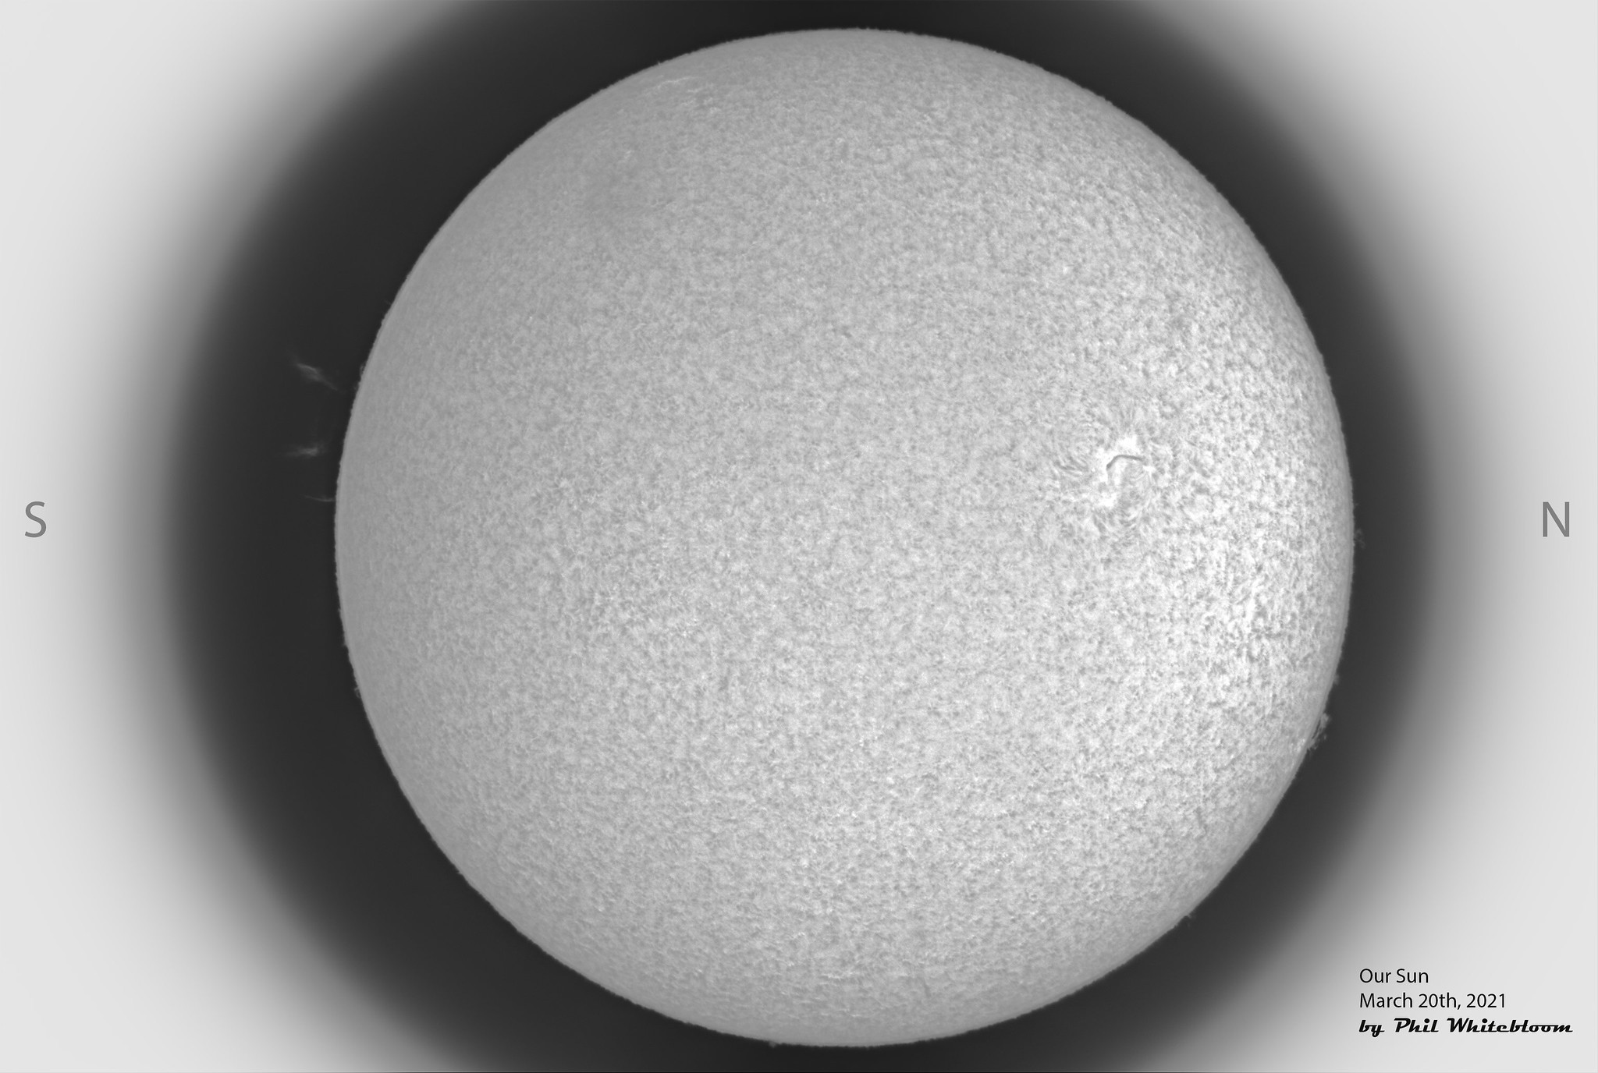

Slide 27
Phil Whitebloom

Slide 28
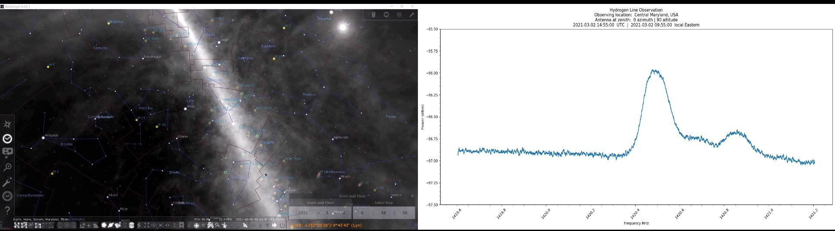

Slide 29
Thank You
CLEAR SKIES!
STAY HEALTHY!

